Slide 1
Soil Dynamics
Slides based off of dissucssions in
Bolker et al. (1998). Linear analysis of soil decomposition: Insights from the CENTURY model. Ecological Applications 8(2): 425-439.

Slide 2
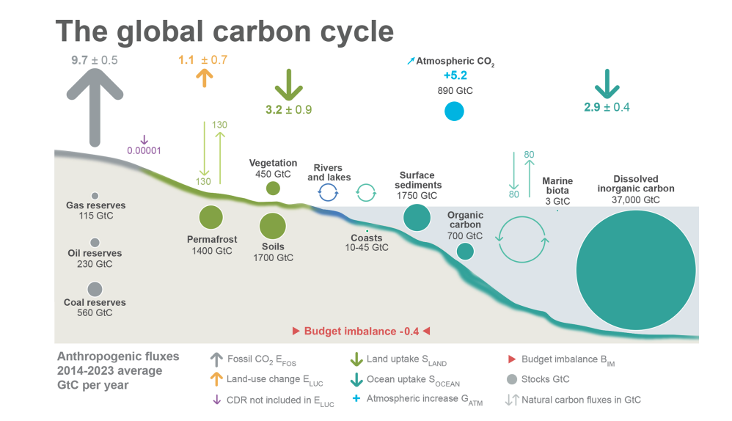
Why soils?
Lots of C in soils!
Friedlingstein et al. (2024)

Slide 3
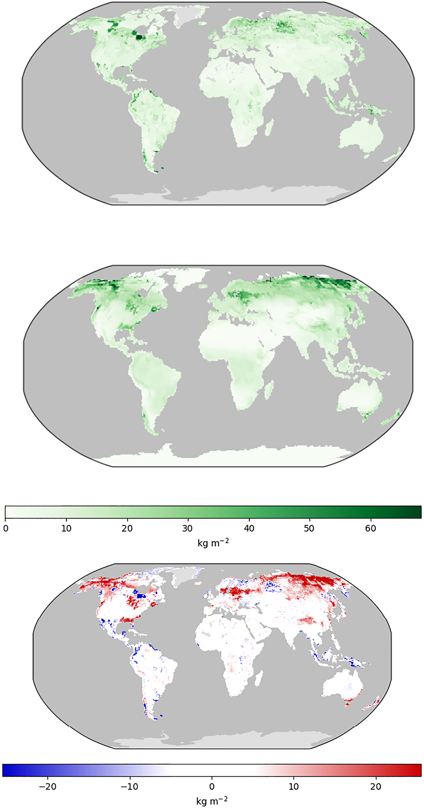
Why soils?
Observation 1
Observation 2
Although it’s hard to know how much!
Difference
Stitch et al. (2024)

Slide 4
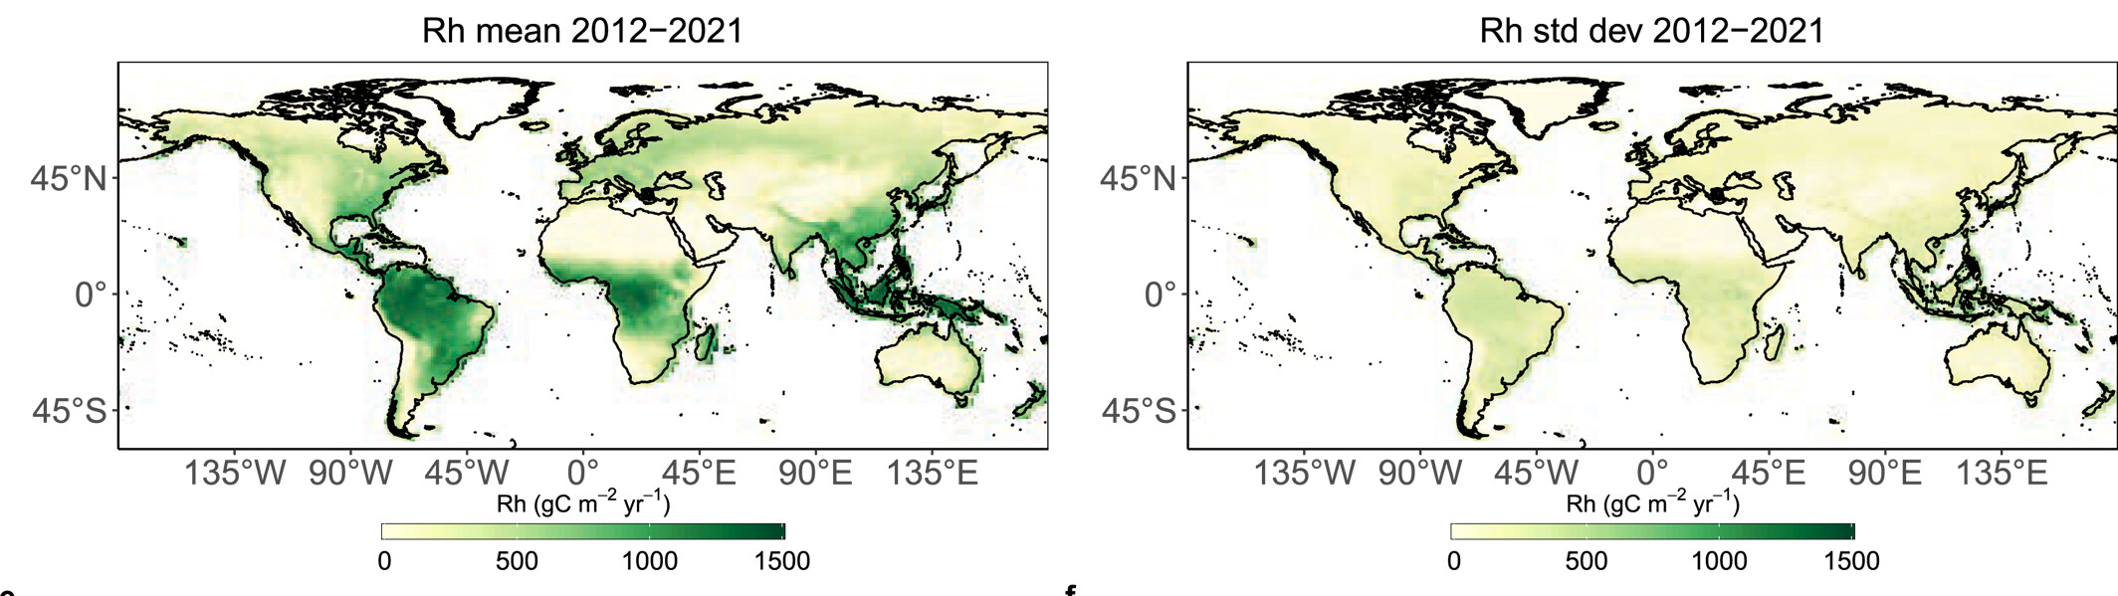
Why soils?
Soils are alive! But how much so?
Stitch et al. (2024)

Slide 5
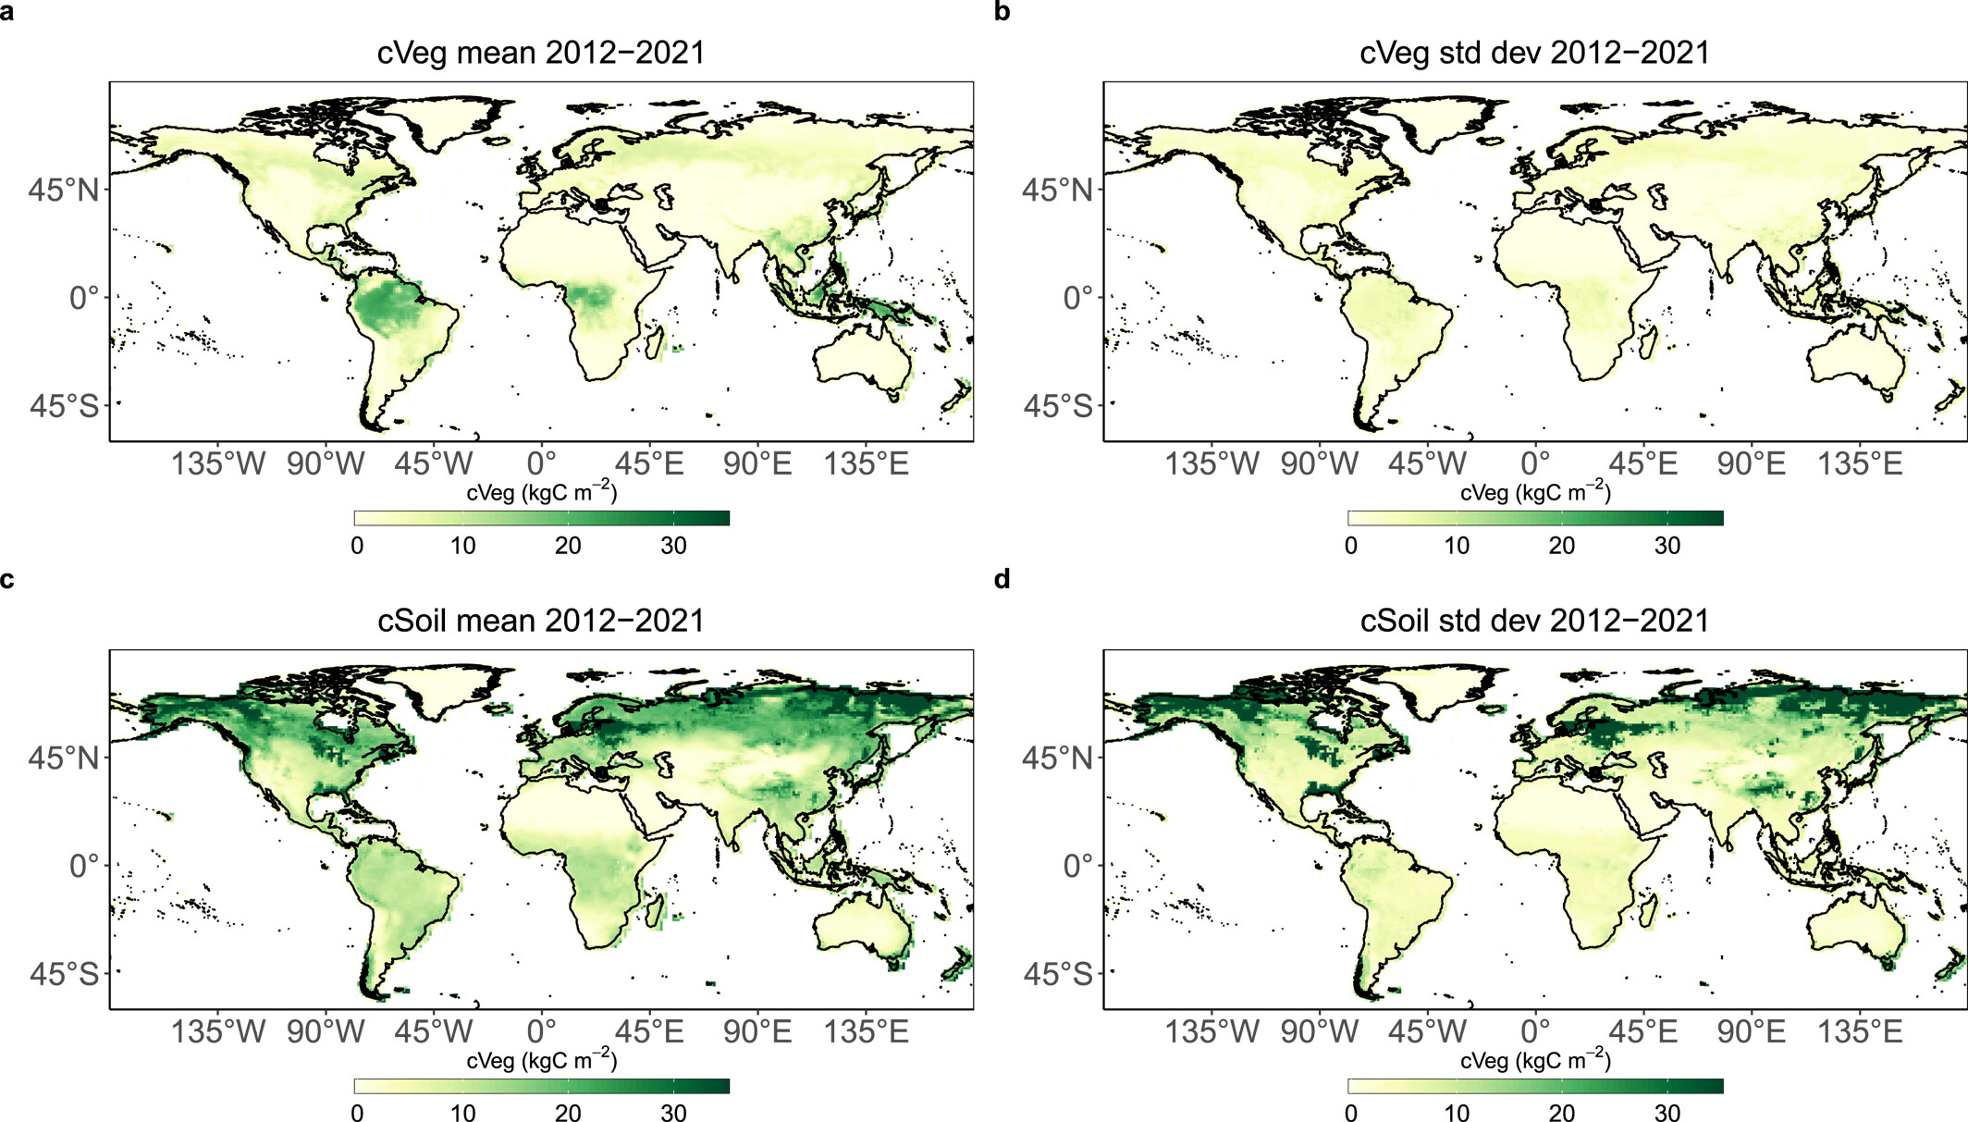
Why soils?
Models are uncertain!
Stitch et al. (2024)

Slide 6
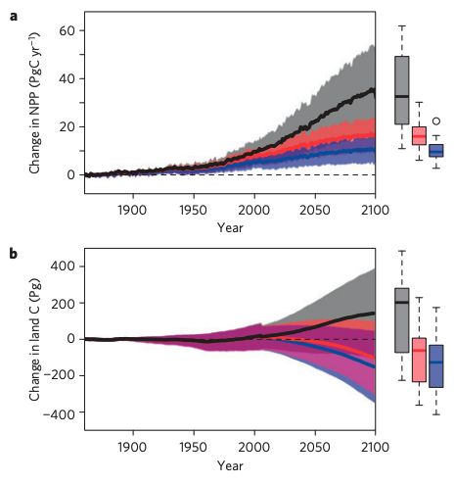
Why soils?
They are also drivers of C-N dynamics
Weider et al. (2015)

Slide 7
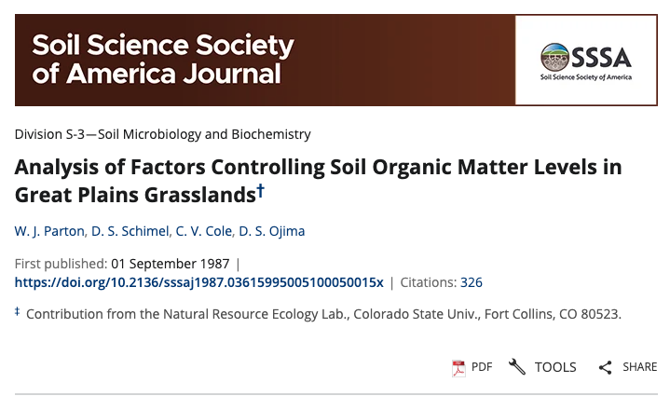
How do we model soils? CENTURY as an example

Slide 8
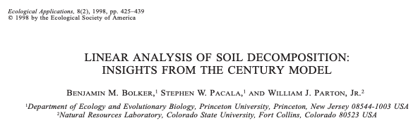
Outline of Bolker et al. (1998)
Structure of CENTURY
Modeling soil C decay in CENTURY
Carbon
Carbon + Nutrients
Simplification of ecosystem Models

Slide 9
Structure of CENTURY

Slide 10
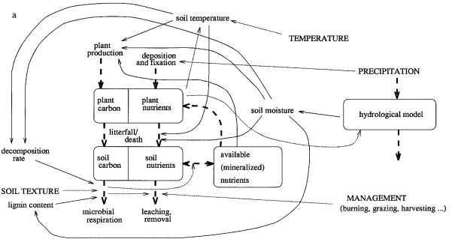
Bolker et al. (1998)

Slide 11
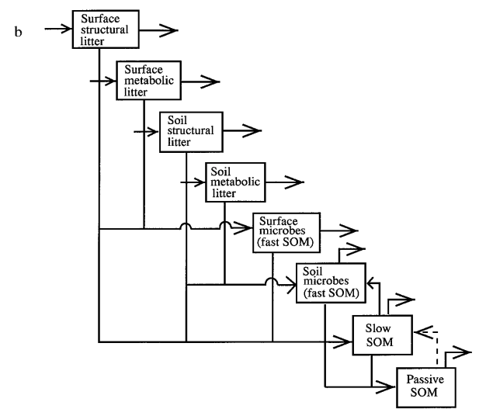
Bolker et al. (1998)

Slide 12
Modeling soil C decay

Slide 13
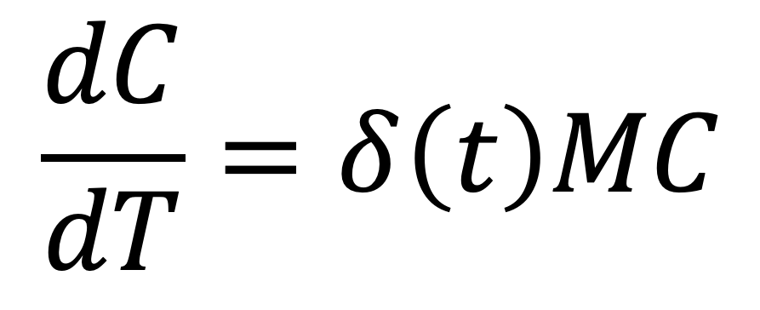
$$\frac{dC}{dT}=δ\left(t\right)MC$$
C = vector of C in each compartment (g)
T = time (yr)
δ(t) = decomposition factor (unitless?)
M = m_{ij} or rate which material from j goes to i (yr⁻¹)

Slide 14
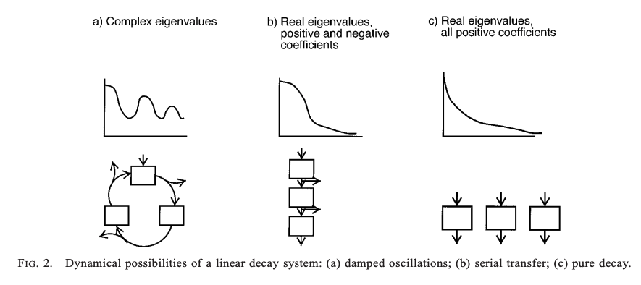
CENTURY tends to devolve to (c)

Slide 15
CENTURY tends to devolve to (c), meaning every C molecule is completely decomposed (returned to atmosphere or moved to more recalcitrant pool)

Slide 16
CENTURY tends to devolve to (c), meaning C can be partitioned instantaneously depending on time scale of interest

Slide 17
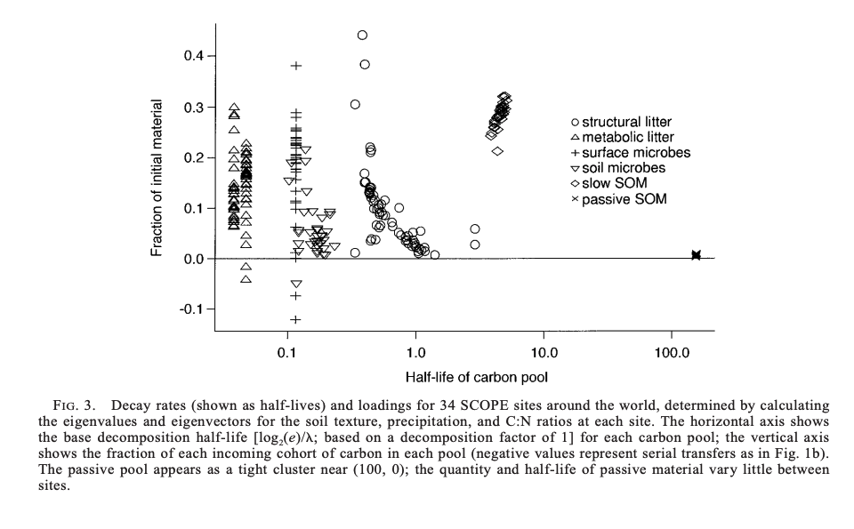
Positive values indicating continuous flow through pools (but note the passive pool)

Slide 18
CENTURY approach to nitrogen
N model ignores explicit C dynamics
N model is a closed system (recycling between plants and soil)
N limits growth if water and temperature are not limiting

Slide 19
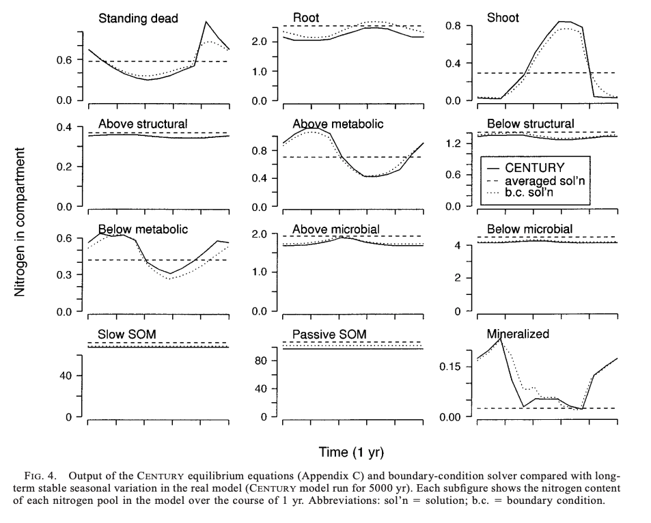

Slide 20
Simplification of ecosystem models

Slide 21
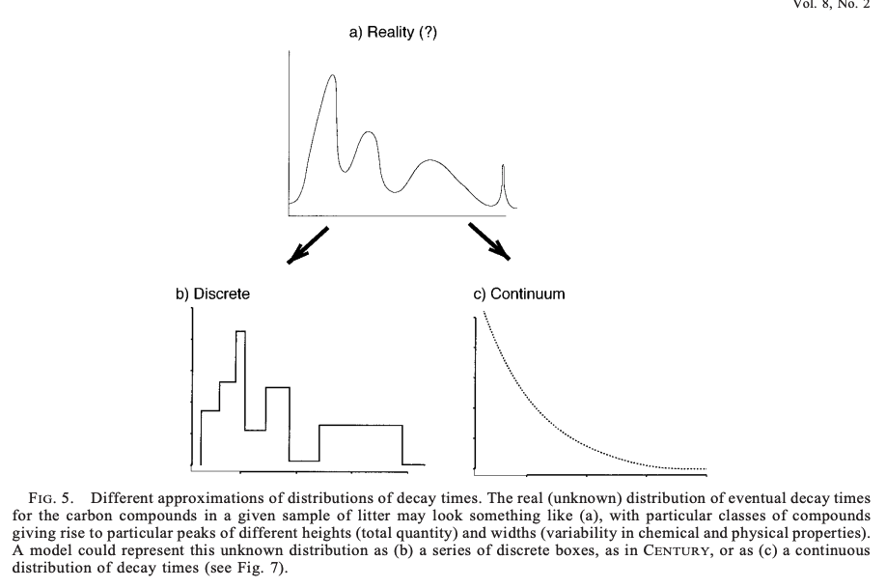

Slide 23
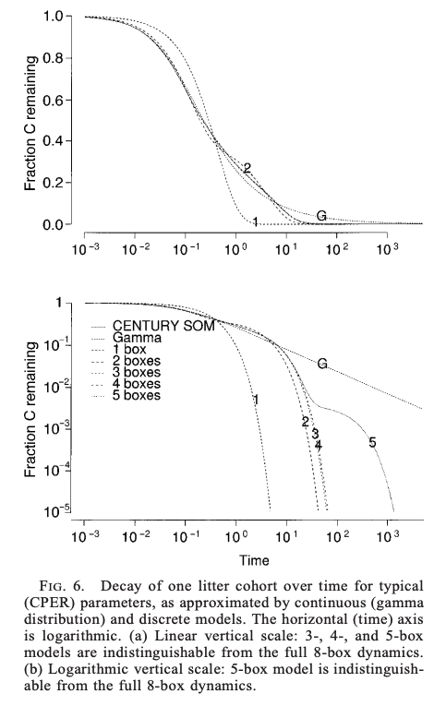
Discrete: how many levels to use?

Slide 24
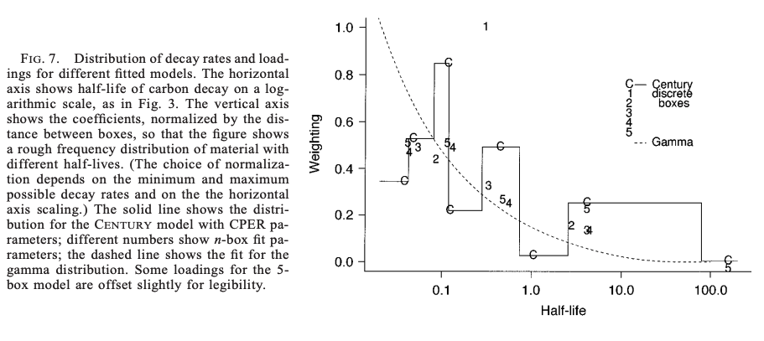

Slide 25
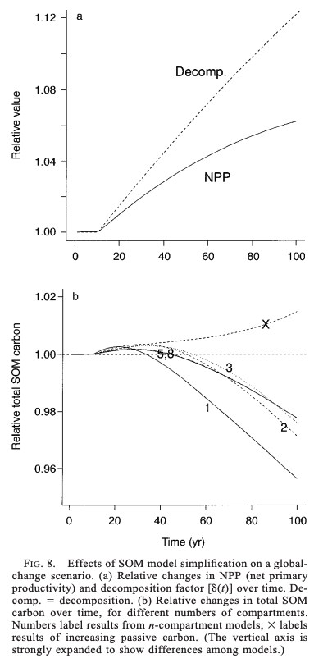

Slide 27
Is a continuous model distribution better?
Need to pick a distribution
And associate parameters
Depends on availability of data and application for the model

Slide 28
Some general takehomes
CENTURY can be simplified
Simple models are easier to understand
E.g., parameter sensitivity
Construct simplest model first and continuously test added complexity
More validation for the class approach!

